Slide 1

Project 1 for STA323
12110821
ZHANG Chi
4/24/2024

Slide 2
01
Security
Data Analysis

Slide 3
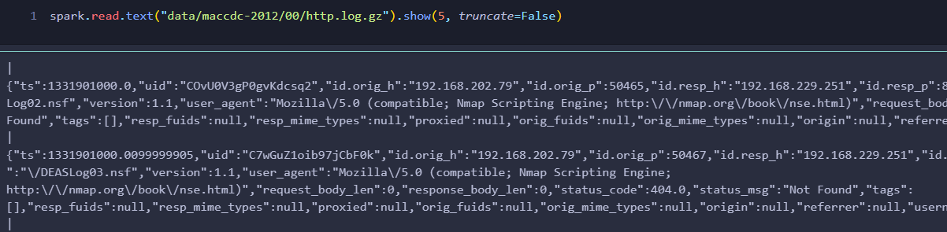
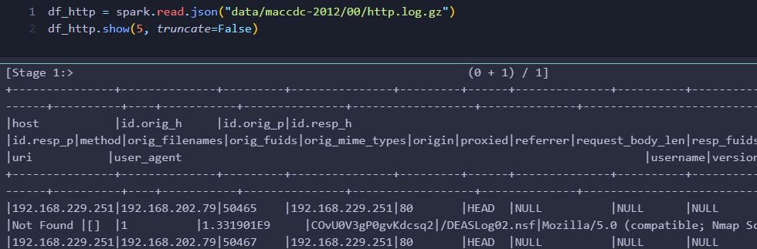
Question 1 - (1)
spark.read.text()
json
spark.read.json()

Slide 4
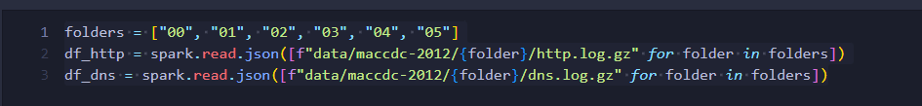
Question 1 - (1)
spark.read.text()
json
spark.read.json()
Given a path list, the function should read the data from the path list and return a dataframe.

Slide 5
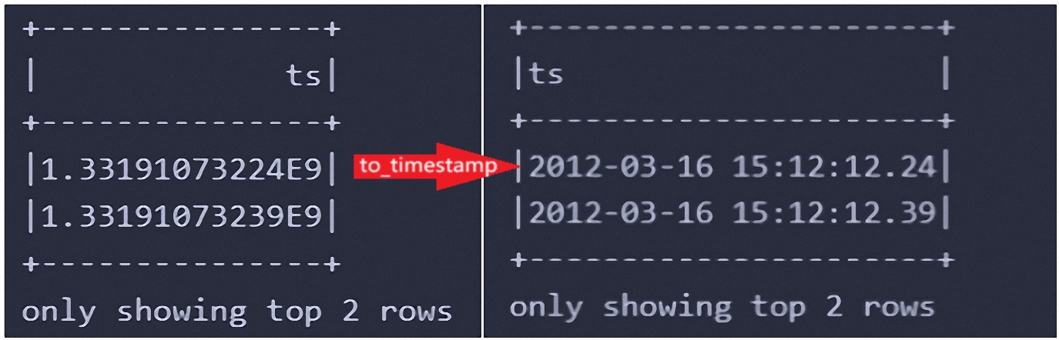
Question 1 - (1)
to_timestamp() & withColumn()

Slide 6
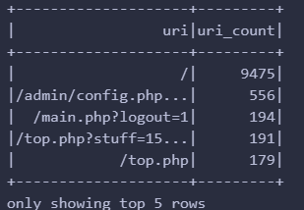
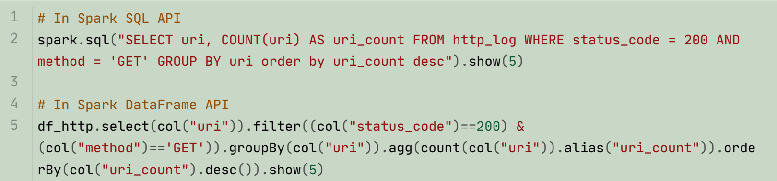
Question 1 - (2)

Slide 7
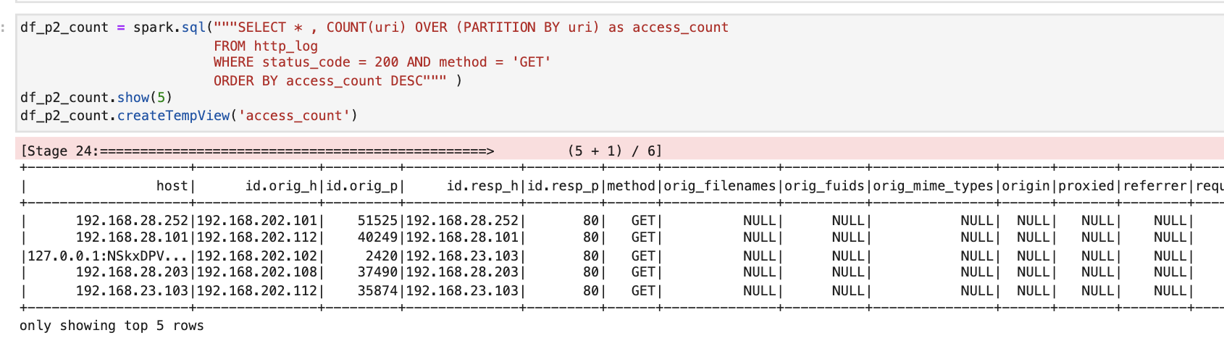
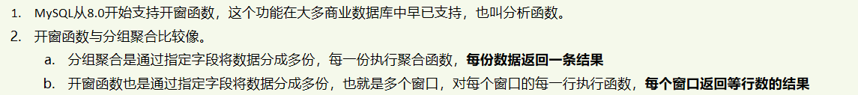
Question 1 - (2)

Slide 8
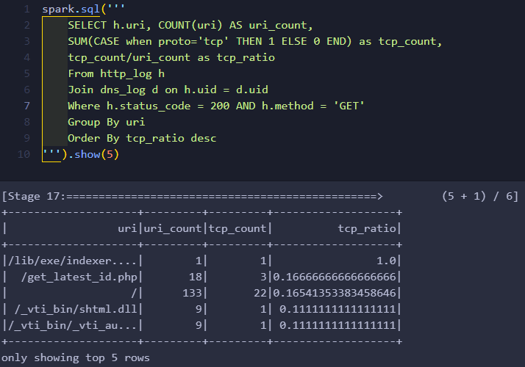
Question 1 - (3)
Inner joining two tables by uid ,
Filtering the records,
SUM(CASE when proto=‘tcp’ THEN 1 ELSE 0 END)
Results are sorted by the tcp_ratio in descending order
Top records are showed.

Slide 9
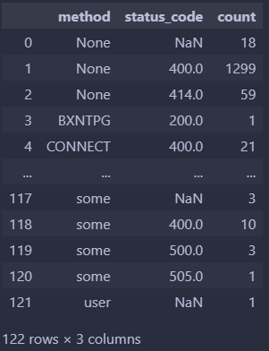
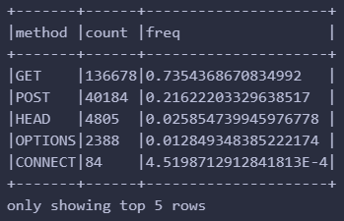
Question 1 - (4)
groupBy()
groupBy() and agg()

Slide 10
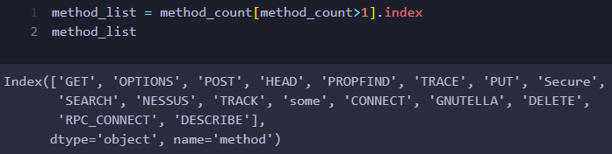
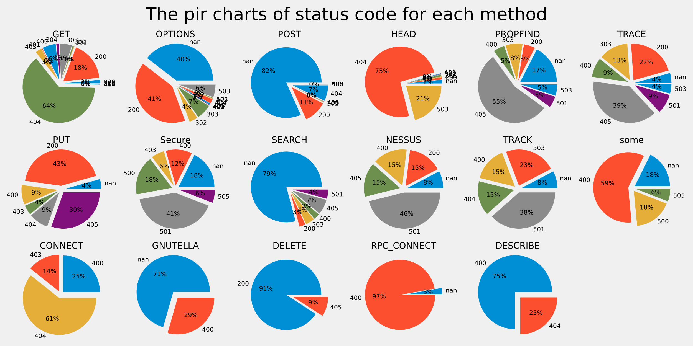
Question 1 - (4)
drop None but keep NaN
emerging once will also be scrapped

Slide 11
Question 1 - (3)

Slide 12
02
WEBSITE SCRAPING AND ANALYSIS

Slide 13
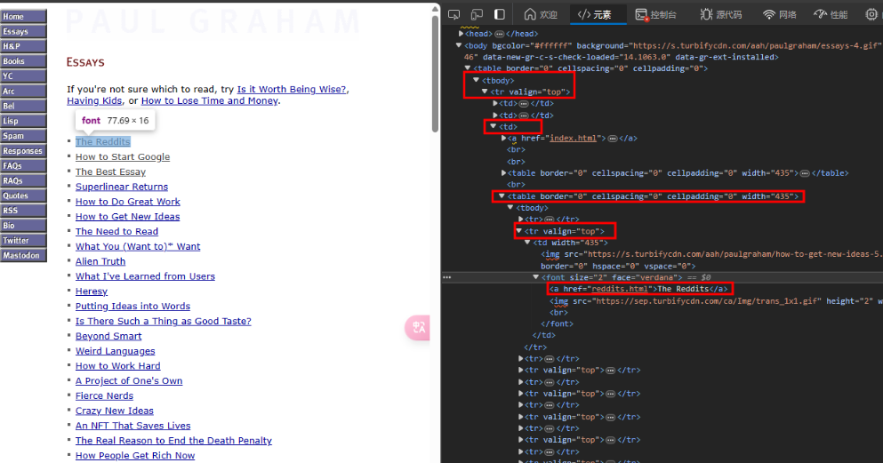
Question 2 - (1)
request to get the data from the given website and use
BeautifulSoup to parse the data
find_all() to get a link list

Slide 14
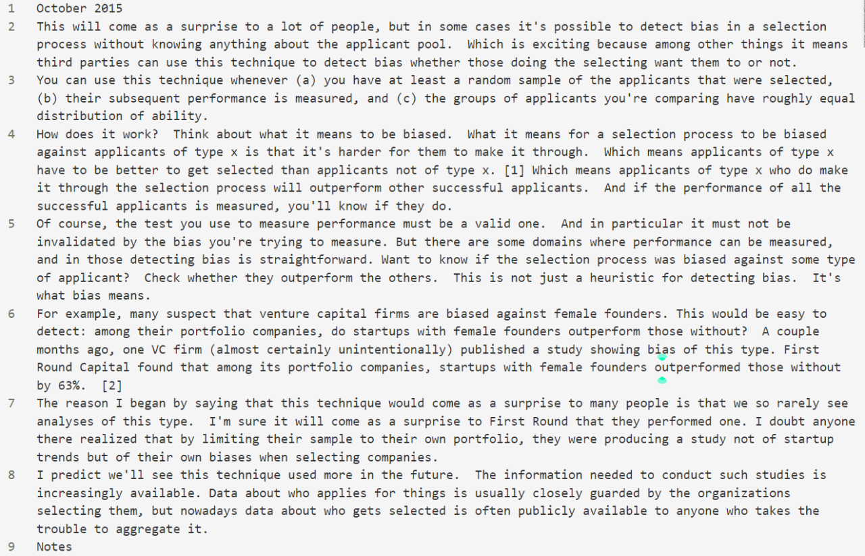
Question 2 - (1)
Convert the soup object into a string
Replace '\n' into ""
Split the string by <br/><br/>
Replace some special characters in the title

Slide 15
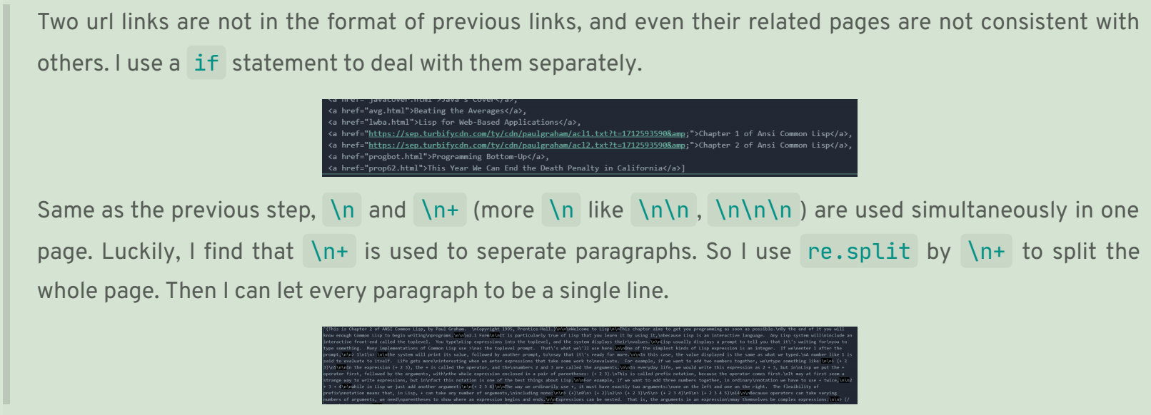
Question 2 - (1)

Slide 16
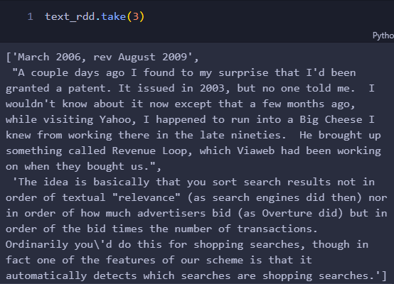
Question 2 - (2)
text_rdd = spark.sparkContext.textFile("data/paul_articles/*.txt")

Slide 17
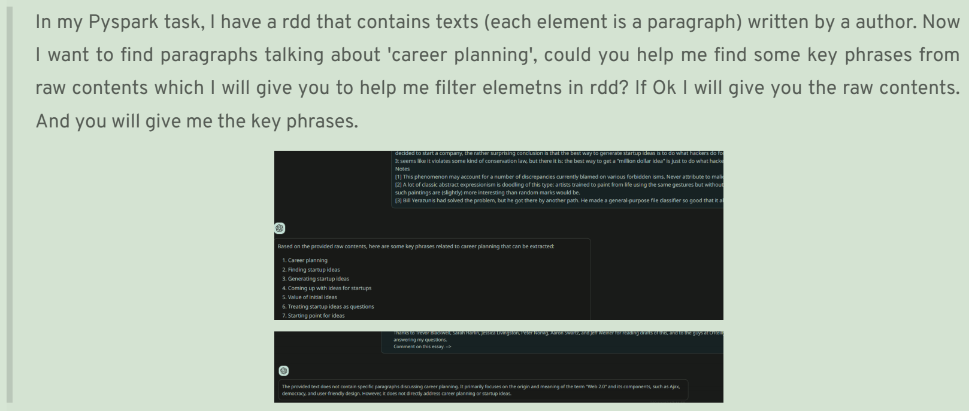
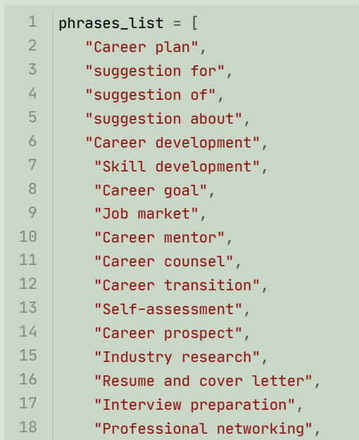
Question 2 - (2) - ChatGPT prompts

Slide 18
Question 2 - (2)
For each phrase in the phrases_list , I will tokenize it to a small phrase_tuple. If one paragraph contains all words of any phrase_tuple (even in disorder or in different morphologys), I will consider it as a paragraph talking about career planning, which will be kept in the final result.
Let all tokens in the paragraph be the nodes of a graph, and the edges are the co-occurrence of two words in the same paragraph. Then I will use a graph algorithm to find the subgraph that contains all nodes in the phrase. If the subgraph is connected, the paragraph is considered to be talking about career planning.
√

Slide 19
Question 2 - (2)
Choose the first way
Word tenses and case should be ignored
Convert words into lower cases
Normalize: deleting letters, e.g. coming => come => com ------- ? common

Slide 20
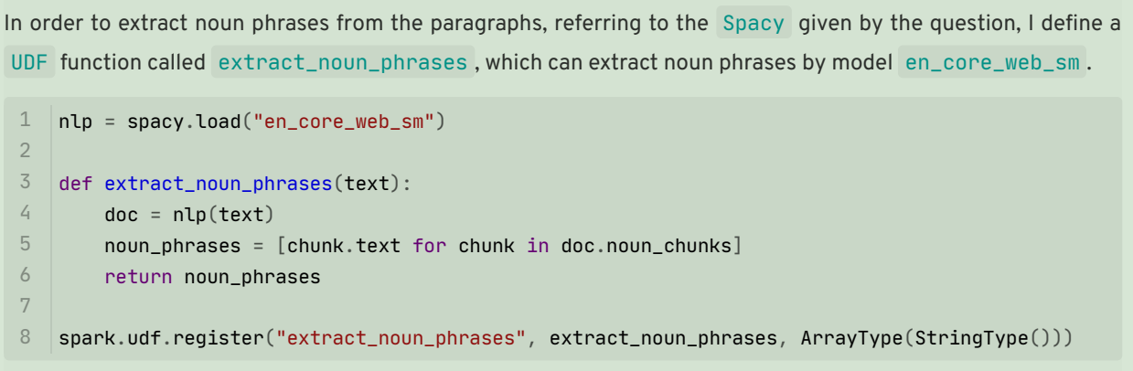
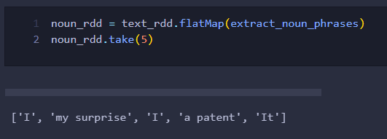
Question 2 - (3)

Slide 21

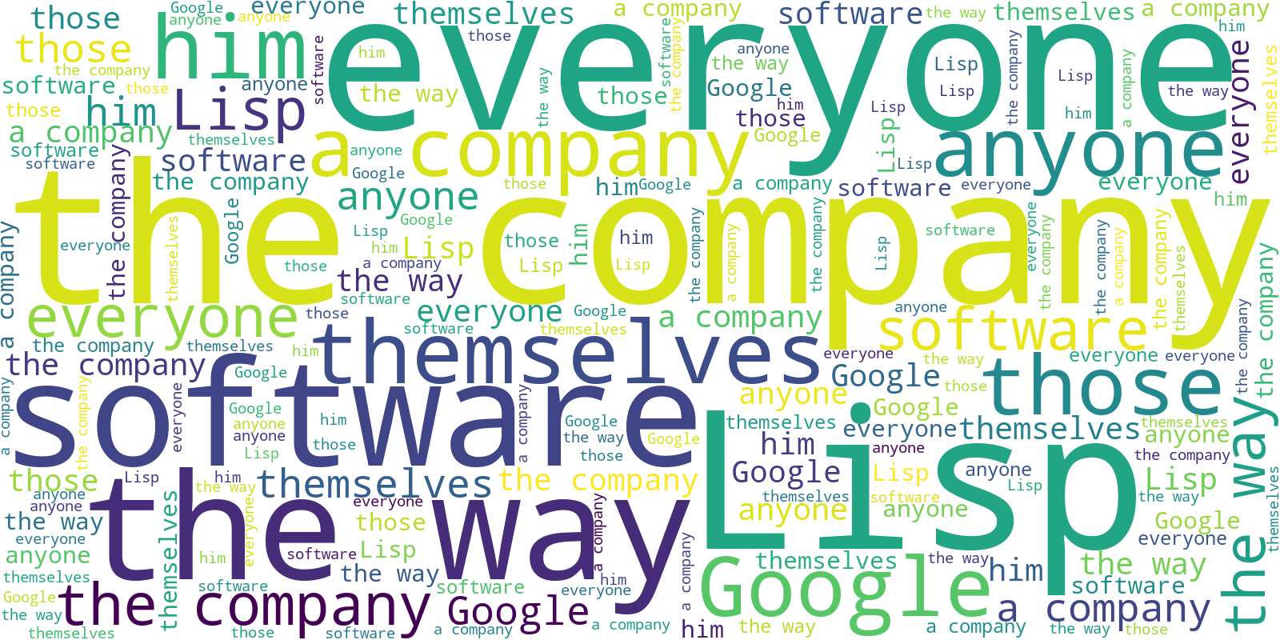
Question 2 - (3)
Stylecloud
Wordcloud

Slide 22
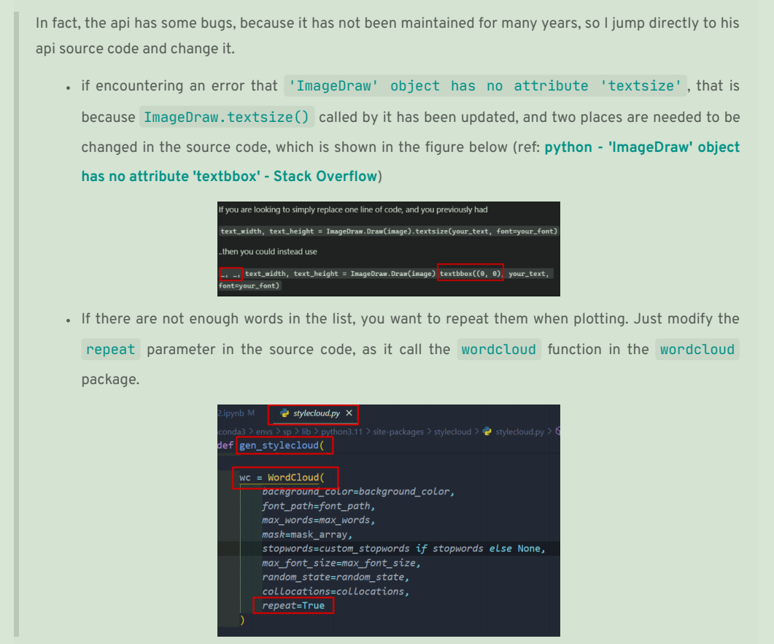
Question 2 - (3)

Slide 23
THANKS FOR LISTENING
12110821
ZHANG Chi
4/24/2024

